Slide 1
HEALTHCARE ANALYTICS PROJECT Patient admission & Billing datasets
KIBIDI K. LERENCER| 00/05/2026 Chuka University: Center For Data Analytics & Modeling Registration No: CDAM/0047/2026 Instructor: LEC CHANON

Slide 2
SECTION 1: EXECUTIVE SUMMARY & KPIs
1. What is the total billing amount across all patients? 1.33m
2. What is the average length of stay (DaysSpent) per patient? 4 days
3. What is the overall payment collection rate? (Paid-44%, Pending-29% & Denied-27%)
4. How many total patient admissions are in the dataset? 151
5. What is the average cost per patient? (Total Billing / Total Patients) 8,810
6. What is the average out-of-pocket expense per patient? 1,110
7. What percentage of bills are currently denied? 27%
8. What is the total medication cost vs. lab test cost ratio? 180:588

Slide 3
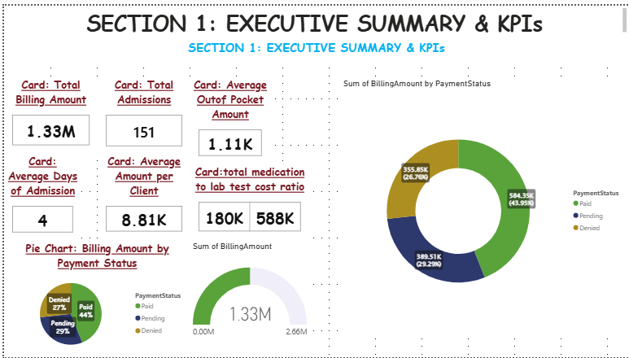

Slide 4
SECTION 2: CLINICAL OPERATIONS ANALYSIS
1. Which hospital has the highest number of admissions? City General -52
2. Which hospital has the longest average length of stay? Reginal Med-4 days
3. What is the distribution of admission types? (Emergency-59 vs Elective-50 vs Urgent-42)
4. Which medical condition is most frequently admitted? Diabetes -34
5. What is the average length of stay by medical condition? 3.6
6. Which hospital has the highest emergency admission rate? Reginal med
7. What percentage of patients had abnormal test results? 44%
8. Which medical condition has the highest rate of abnormal test results? Diabetes, Heart Failure, Pneumonia:17
9. Howmany patients were admitted per hospital? City General: 54, Reginal Med:44, Metro Health:48
10. What is the bed turnover rate by hospital? (Admissions / Avg Days Spent):CG;17, MH:14, RM:12

Slide 5
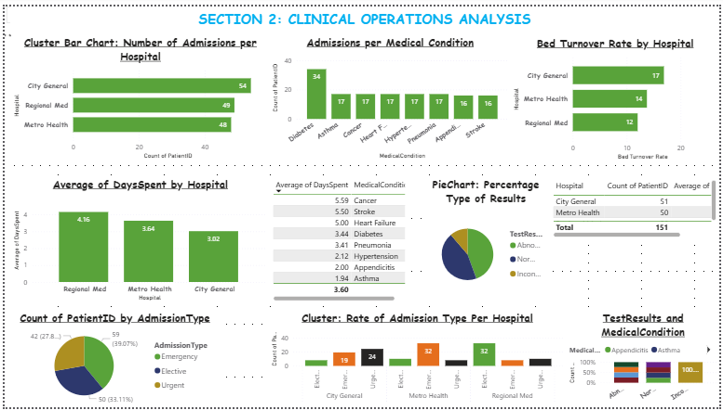

Slide 6
3: FINANCIAL PERFORMANCE ANALYSIS
1. What is the total revenue by payment status? (Paid;0.6M vs Pending:0.4M vs Denied:0.4M)
2. What is the average billing amount per medical condition?S-24K,C-18K,HF-14K,AP-8K,D-4.5K,H-3.3K,AS-2.0K
3. Which medical condition generates the highest revenue? STROKE
4. What is the total outstanding amount? (Pending + Denied): 745,360
5. What is the revenue collection efficiency? (Paid Amount / Total Billing) 43.95%
6. Which procedure code has the highest average billing amount? 99225
7. What is the average billing amount by hospital?CG-8259,MH-9046,RM-9173
8. Which hospital has the highest denial rate? Regional med: 34%
9. What is the month-over-month revenue trend? moderate:Jan, peak:Feb, Drops: March
10. What is the average revenue per doctor? Dr.Kim

Slide 7
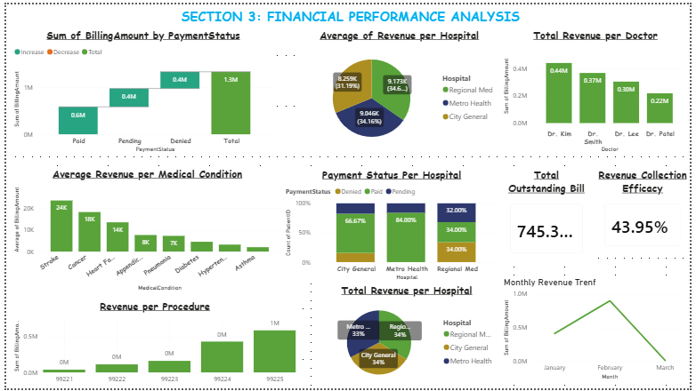

Slide 8
4: INSURANCE/PAYER ANALYSIS
1. What is the patient distribution by insurance provider?Medicare:28%,Medicaide; 25%,united Health:25%,Aetna :23%
2. Which insurance provider has the highest denial rate?Aetna: 11%
3. What is the average billing amount by insurance provider? UH: 11,903, MCARE:8,748,AT:8682, MCAID:5893
4. Which insurance provider has the highest average out-of-pocket cost for patients? UNITED HEALTH
5. What is the payment success rate by insurance provider? (% Paid)MEDICARE:23%
6. Which insurance provider covers the most expensive conditions? STROKE,MCARE,UN
7. What is the average patient financial burden by payer? (Out-of-Pocket / Total Bill): 12.61%
8. Which insurance has the highest pending payment rate? United Health
9. Compare total revenue collected from Medicare vs Private insurers?
10. What is the average medication cost coverage by insurance type? Aetna;1435, UH;1424, MCARE:1232, MCAID:692

Slide 9
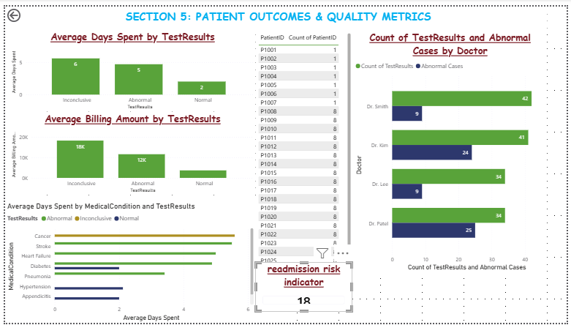

Slide 10
5: PATIENT OUTCOMES & QUALITY METRICS
1. What is the correlation between test results and length of stay?Inconclusive:6, Abnormal:5, Normal:2: Those with normal results stay fewer days while those with abnormal results stay longer while those with inconclusive results stay longest
2. Do patients with abnormal test results have higher billing amounts? NO : Inconclusive has the highest billing amount.IN;18.2k, ab;16.2K,N:3.7K
3. Which medical condition has the worst outcomes? (Abnormal results + Long stay) Cancer
4. What is the readmission risk indicator? (Patients with multiple admissions) 18
5. Which doctor has the highest rate of abnormal test results?
6. Is there a relationship between admission type and test outcomes?
7. What percentage of emergency admissions result in abnormal findings?
8. Which hospital has the best patient outcomes? (Normal results %)
9. What is the average cost for patients with abnormal vs normal results?
10. Are elective admissions more cost-effective than emergency?

Slide 12
5: PATIENT OUTCOMES & QUALITY METRICS
1. What is the correlation between test results and length of stay?
2. Do patients with abnormal test results have higher billing amounts?
3. Which medical condition has the worst outcomes? (Abnormal results + Long stay)
4. What is the readmission risk indicator? (Patients with multiple admissions)
5. Which doctor has the highest rate of abnormal test results?
6. Is there a relationship between admission type and test outcomes?
7. What percentage of emergency admissions result in abnormal findings?
8. Which hospital has the best patient outcomes? (Normal results %)
9. What is the average cost for patients with abnormal vs normal results?
10. Are elective admissions more cost-effective than emergency?

Slide 14
SECTION 6: RESOURCE UTILIZATION
Questions to Answer:
1. Which doctor has treated the most patients?
2. What is the average number of patients per doctor?
3. Which doctor handles the most emergency cases?
4. What is the average revenue generated per doctor?
5. Which doctor has patients with the longest average stay?
6. What is the doctor workload distribution by hospital?
7. Which doctor treats the most complex cases? (High billing + Long stay)
8. What is the patient-to-doctor ratio by hospital?
9. Which doctor has the highest medication prescription rate?
10. Are certain doctors associated with specific insurance providers?
Suggested Visuals:

Slide 16
7: COST BREAKDOWN ANALYSIS
Questions to Answer:
1. What percentage of total billing is medication cost?
2. What percentage of total billing is lab test cost?
3. Which medical condition has the highest medication cost?
4. Which condition requires the most expensive lab tests?
5. What is the average out-of-pocket percentage by condition?
6. Do emergency admissions have higher lab test costs?
7. What is the cost composition by hospital? (Medication vs Lab vs Other)
8. Which procedure code has the highest medication-to-total cost ratio?
9. What is the relationship between days spent and lab test costs?
10. Which insurance provider patients have the highest out-of-pocket burden?

Slide 18
SECTION 8: TIME-BASED TRENDS
1. What is the monthly admission trend?
2. Which month had the highest revenue?
3. Are there seasonal patterns in emergency admissions?
4. What is the week-over-week billing trend?
5. Which day of the week has the most admissions?
6. How does average length of stay vary by month?
7. What is the trend in denial rate over time?
8. Are medication costs increasing over time?
9. Which month had the highest patient out-of-pocket expenses?
10. What is the projected revenue for next quarter? (Based on trend)

Slide 20
9: ADVANCED ANALYTICS & DAX CALCULATIONS
Questions to Answer:
1. What is the cost per day by medical condition? (Total Cost / Days Spent)
2. Calculate the financial risk score per patient? (Out-of-Pocket / Income proxy)
3. What is the running total of revenue month-to-date?
4. Calculate year-over-year growth rate? (If historical data available)
5. What is the patient lifetime value estimate? (Based on condition complexity)
6. Create a cost efficiency score for each hospital? (Outcomes / Cost)
7. What is the rolling 7-day average of admissions?
8. Calculate the variance from average cost per condition?
9. What-if analysis: If denial rate decreases by 10%, what's the revenue impact?
10. Rank hospitals by overall performance? (Cost + Outcomes + Efficiency)

Slide 22
10: COMPARATIVE & DRILL-THROUGH ANALYSIS
1. Compare City General vs Metro Health performance across all metrics?
2. Which doctor-hospital combination is most cost-effective?
3. Analyze the complete patient journey for high-cost cases?
4. What are the top 3 cost drivers for Cancer patients?
5. Compare Medicare vs Aetna patient outcomes and costs?
6. Which medication is most prescribed for Diabetes patients?

